Slide 1
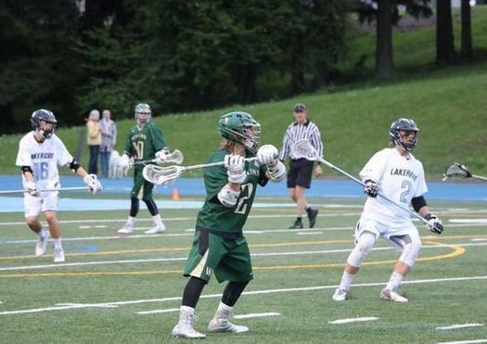

WEST LINN YOUTH LACROSSE
Parent/Player Informational Meeting
February 1, 2023

Slide 2
WLYL BOARD
President – Joe Brookhouse
Vice President/Scheduling – Heidi Lopez
Treasurer – Scott Mueller
Equipment – Jenni Sclater
Referees – Mark Flood

Slide 3
WLYL Philosophy
Focus on FUN
Practice is mandatory
Sportsmanship is Paramount - Not wins and losses
No team/carpooling requests
Kids play with same grade group - we don’t play up

Slide 4
Weather & WLWV SD Policy
We play sun, rain, snow, etc.
We follow field closures for WLWV School District and WL Parks
If lightning or thunder:
  Activities stop
  Resume 30 minutes after last reported sighting/sound
  Be on call!

Slide 5
WLYL Concussion Protocol
If child sustains head injury, he sits and removes equipment
Parents take child to MD for concussion testing
Parents notify coach and WLYL President/Vice President or Mark Flood
Child sits until MD clearance (we need MD paperwork)
After MD clearance, child resumes light workouts - no contact
If child experiences no ill effects from workouts, he resumes play with Parental/MD consent

Slide 6



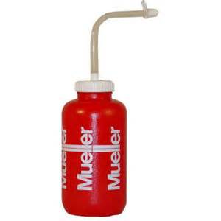
Equipment
Stick
Shoulder pads, arm pads, gloves - Get fitted!
Helmet properly fitted and buckled. Name taped on front and back of helmet.
Mouthpiece (no mouthpiece = no play)
Tied cleats
Water Bottle w/ Child’s Name
Athletic Supporter and Cup
WLYL Shorts and Jersey
NO!
YES!

Slide 7
LaxNW 2023 Player Package
Individual
STX Stallion 75 Gloves - $30
STX Stallion 75 Elbow Pad - $25
STX Stallion Shoulder Pad - $35
STV Stallion Complete Stick - $40
Cascade Helmets - $xx
Combo
Glove, Elbow, Shoulder - $80
Glove, Elbow, Shoulder, & Stick - $115
Combos are limited to the above listed products – no substitutions
LAXNW TRF
9630 SW Tualatin Sherwood Rd
Tualatin, OR 97062
503.454.0941
Notes:
Mark: Speak to helmets

Slide 8

LaxNW
LAXNW TRF
9630 SW Tualatin Sherwood Rd
Tualatin, OR 97062
503.454.0941
https://www.laxnw.com/

Slide 9
WLYL Preseason Training
At WLHS main stadium
Grades 1-2: DO NOT ATTEND Preseason Training Sessions
Newcomer Clinic: February 11, 10am – 12pm
Grades 3-8: Begins February 11, 3/4 12 – 1pm, 5-8 1:00 – 2:30pm
Super Crosse Sunday: February 12
Check webpage (www.westlinnlax.com) for dates and times – “Youth Information” tab

Slide 10
WLYL Grades 1-2
Location:
West Linn High School stadium
Practices:
Sunday afternoons
Apr 2 – May 21
Check webpage – “Youth Information” tab
Have child dressed and ready to go.
Parents leave children, do not come on field or walk track.
Drills/fun games and basic skills focus with HS players.

Slide 11
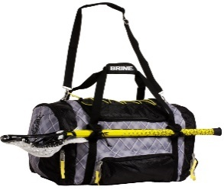
WLYL Grade 3-4 Schedule
Location:
Mary S Young Park
Practice and Games:
Coach sets game schedule, posted online
March 20 – May 28
Mon and Weds 5:30-7pm
All teams practice two nights a week together (no extra individual team practices)
One game a week - show up 45 min early
Played like basketball - no offsides
Ensure child does not leave trash or equipment behind
ALL WL TEAMS ARE EQUAL!

Slide 12
WLYL Grade 5-8 Schedule
Location:
Practice: AH/Parker Road, March 20 – May 28
Games: Rosemont Ridge or WLHS
Grades 5/6
Practices Mon and Weds at Parker Road (5:30-7:15 pm) with weekday/weekend games).
All players play all positions!
Grades 7/8
May have some early faceoff and goalie training
Practices Tues and Thurs @ Parker Road (5:30-7:30 pm) with weekday/weekend games

Slide 13
WLYL Grade 5-8 Schedule
Two practices (Alison Henderson Field) and a Sat game
Teams practice together
Players suit up before taking practice field
No parents on school property.
Ensure child does not leave trash or equipment behind (lax bag?)
ALL WL TEAMS ARE EQUAL (no A, B, C teams - We are in Division 1 (not Premiere League)

Slide 14
WLYL Select Team
Grades 5-8
Late April - Tryouts for 5/6 and 7/8 Select takes place after Spring games
Must meet all regular commitments (games, etc.) if you play Select.

Slide 15
Parental Responsibilities
Learn the game from your child: Attend a WLHS or JV game with your child, watch college games on ESPN
Be punctual for practice PICKUP and game day arrival
  Field for MSY and WLHS - not parking lot
Do not attend practice: Drop them off and leave them with us. Do not walk the track or approach your child.
No snacks, no team names (Lions), no trophies…
Games: Sit opposite the team

Slide 16
Parental Responsibilities (cont.)
Do not complain about the officiating!
Do not approach the coaches/refs after a game about an issue - give them a break and let them go home
Major Problems
  Directly to coaches via email or phone
  If it’s major, contact WLYL Board

Slide 17


Slide 18
WLYL Coaches
Head coaches are former players (we do need level-headed parents as Asst. coaches)
Ensure all kids play, have fun, and be a role model (no Bobby Knights)
If your child misbehaves, coaches will remove them from practice and ask that you talk with them about proper behavior before returning
Coaches can’t leave practice/games field until all kids are picked up

Slide 19
Player Responsibilities
No trash talk to opposing players or to kids from other teams at any lacrosse function! You represent West Linn - show class.
Demonstrate good sportsmanship: Bump fists with the other team (“good game”).
Be accountable: If you commit a penalty, own up to it.

Slide 20
Player Responsibilities
Treat officials with respect: Do not complain about the refs or say that was a bad call. Thank them after the game.
Do not leave trash or your equipment - clean the field after the game/practice
Bullying is not tolerated

Slide 21
Player Responsibilities
Put on all your equipment before taking the practice field
Shoot overhand and use two (2) hands on a groundball
Be a good positive teammate - some kids are beginners and need your support
After your goal, thank the teammate who gave you an assist

Slide 22
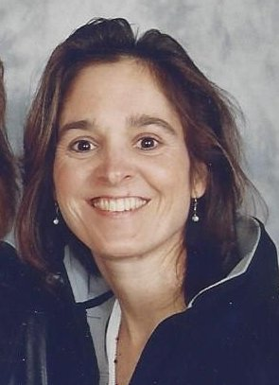
Alison Henderson Field
Parker Road Behind Safeway

Slide 23
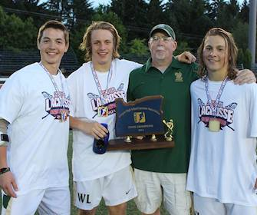
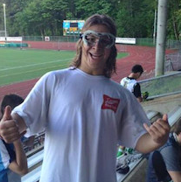
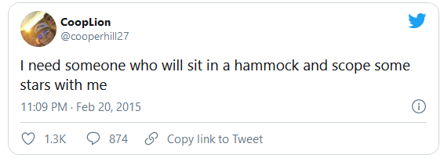
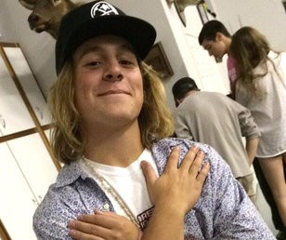
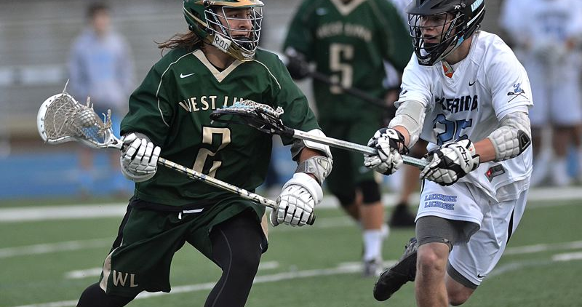
Pink Shirts/Cooper Hill #2
CH2

Slide 24
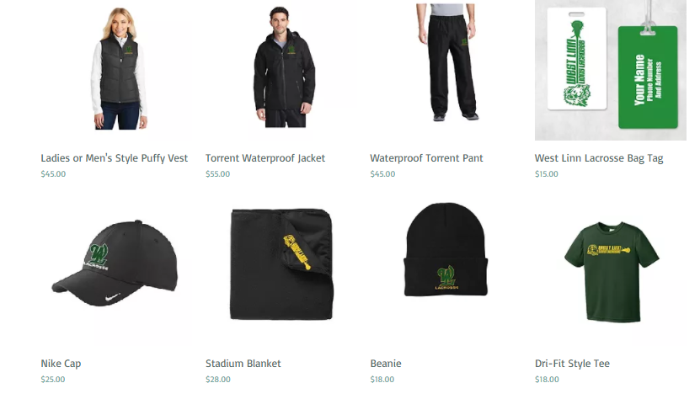
WLYL 2023 Apparel
https://www.kadmark.com/wllax

Slide 25
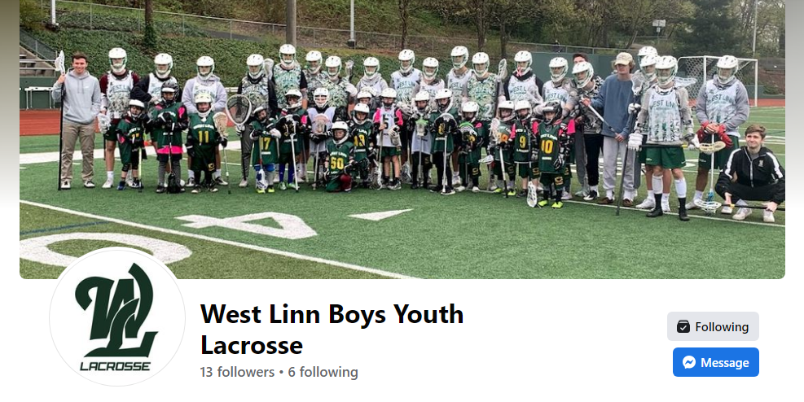
Facebook Page
https://www.facebook.com/westlinnyouthlax

Slide 27
Thank You

